Slide 1
Nightingale Research Foundation
www.nightingale.ca
121 Iona Street
Ottawa, Canada
K1Y 3M1

Slide 2
What is
Myalgic Encephalomyelitis
& Chronic Fatigue Syndrome?

Slide 3
Patients and physicians must stop thinking that M.E. and CFS represent the same pathologies.
They are not the same!

Slide 4
Primary M.E. is…
An acute onset, epidemic & endemic,
Biphasic infectious disease, with an
Incubation period of circa 4 days,
Onset can be any time of year but,
Peak occurrence is late summer,
Most epidemic patients occur in schools, hospitals, residences & post bus or post-air travel in close quarters.

Slide 5
Primary Endemic M.E. Occurs: most often
From July to November in,
In students, teachers & health workers,
Respiratory technicians,
Following or during trips to 3rd world,
Following head or physical trauma,
In patients with previous repeat infections or significant allergies.

Slide 6
Primary Diagnostic Hallmark of M.E. is:
A Properly Performed
Brain SPECT
in a Significantly Physically Exhausted Patient.

Slide 7
Primary M.E.
In M.E. is by definition an encephalopathy demonstrated on any properly performed Brain SPECT, PET or QEEG (BEAM) Scan

Slide 8
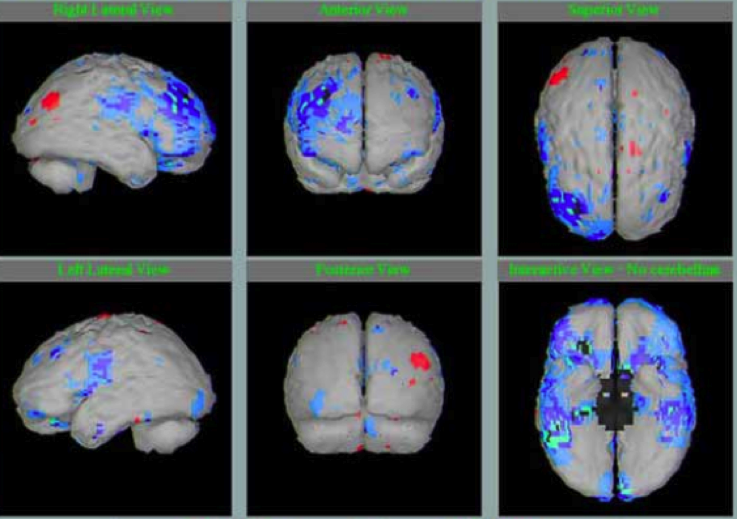

Slide 9
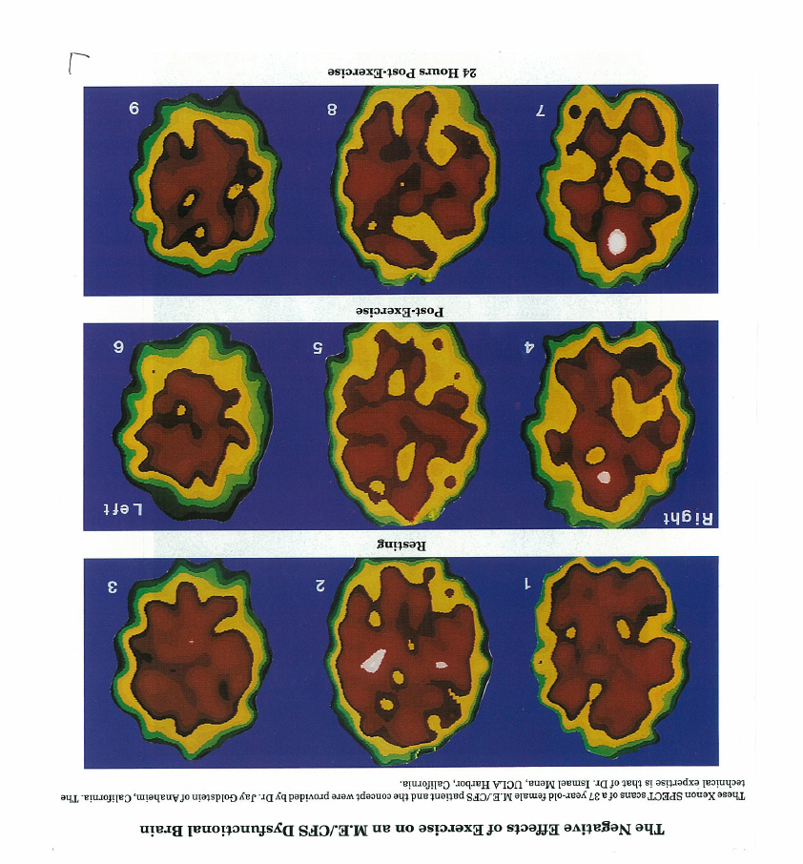
Negative Effects of Exercise on an M.E. Dysfunctional Brain.
Xenon SPECT scans of a 37 year old female M.E. patient.
Findings demonstrated by
Dr Jay Goldstein & Dr Ismael Mena, UCLA, California in 1989
1: Abnormal resting SPECT
2: Post-exercise SPECT
3: 24 hr post-exercise

Slide 10
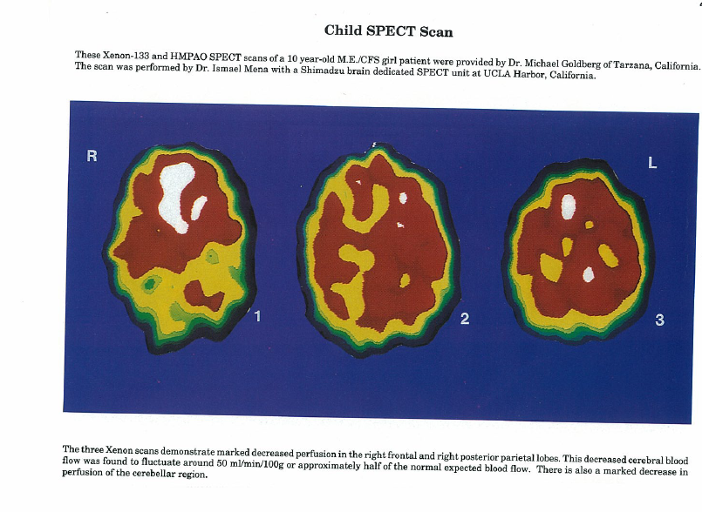
Child SPECT Scan
Zenon Scan of a 10 year old M.E. child’s brain with marked (50%) decreased blood perfusion in the right frontal & right posterior parietal & occipital lobe.
Courtesy of Dr Michael Goldberg & Dr Ismael Mena of California with Shimadzu brain SPECT

Slide 11
Typical Basal Ganglia Injury Dr Vance Spense, Scotland

Slide 12
These brain SPECTs are
Typical M.E. Injured Brains, demonstrating a diffuse vascular and metabolic encephalopathy, aggravated by any, physical, infectious, sensory or emotional stressors.
Typical of 500 of my M.E. patient brain SPECTs

Slide 13
Enteroviruses are the Principal Known Infectious Cause of M.E.

Slide 14
Enterovirus Associations
1946-8 Akureyi (Coxsackie B), Bjorn Sigurdsson
1956 Lyle: Newton-le-Willows, UK, (ECHO):
1984-1992 Hyde Ottawa, (Coxsackie & ECHO enteroviruses):
1988 Mowbray 1984-1988 U.K. & Canadian patients:
1991 Gow: Scottish patients, 1985 -1989
1992 Behan: recovers Enterovirus from M.E. muscle:
1993 L. Archard demonstrates rapid mutations of enterovirus in John Richardson’s Newcastle M.E. patients
1995-1997 Lane: (42/9%) & L. Archard: Persistance & unstable mutations,
2003 Galbraith, Nair: Ruchill, Glasgow: ECHO 24-like virus from 50% of Canadian acute onset patients but 0% from S Straus samples,
Lane, 21% Enterovirus positive/100%.
2007-2010 John Chia: live virus from CFS patients with stomach mucosa, Enterovirus VP1 protein in 82% of 165 M.E./CFS patients

Slide 15
The 1984 M.E. Pan-Epidemic
This was the period from 1985-1990 when so many epidemics & clusters occurred.
In Ontario, The Provincial Viral Laboratory found no relative increase in EBV from previous years but a marked increase in Enterovirus activity in fatigue & brain dysfunction patients.

Slide 16
YEAR
Notes:
This is work by Dr B McLaughlin of the Ontario Ministry of Health in Toronto whose lab examined over 700 serum specimens submitted by Ontario physicians examining for both encephalitis and M.E. like illnesses in Ontario. August 1984 was the month and the year when an M.E. Cluster or epidemic occurred in Lake Tahoe, in the North Carolina Symphonic Orchestra, in Montreal and Ottawa Clusters. In our text book the Clinical & Scientific Basis of M.E. & CFS Dr McLaughlin has a chart of EBV recoveries in the same period. There was no relative increase. See page 293.

Slide 17
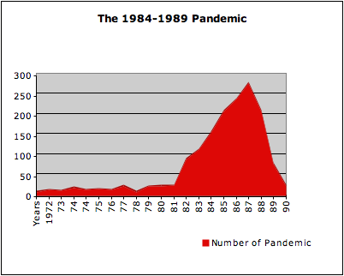
Illness Onset Year in 1200 M.E. Canadian Patients

Slide 18
Nightingale, Ruchill Glasgow Hospital Viral Study
100 M.E. and CFS Canadian patient’s blood was studied at Ruchill, Glasgow Hospital, Scottish Enteroviral Study Centre.
60 were gradual onset CFS patients.
40 were acute onset M.E. patients

Slide 19
Nightingale, Ruchill Hospital Viral Study
The 60 gradual onset CFS patients had no evidence of enterovirus .
20 of the 40 acute onset M.E. patients had PCR evidence of enterovirus.
Notes:
Icubation period was 2 days. Also, 2 0f the 20 positive patients fell ill after a massive transfusion. In other words, taken as a group ENTEROVIRUS represented only 20% which already is significant. However taken as a fraction of the 40 M.E” acute onset patients, 50% had PCR evidence of Enterovirus infection.

Slide 20
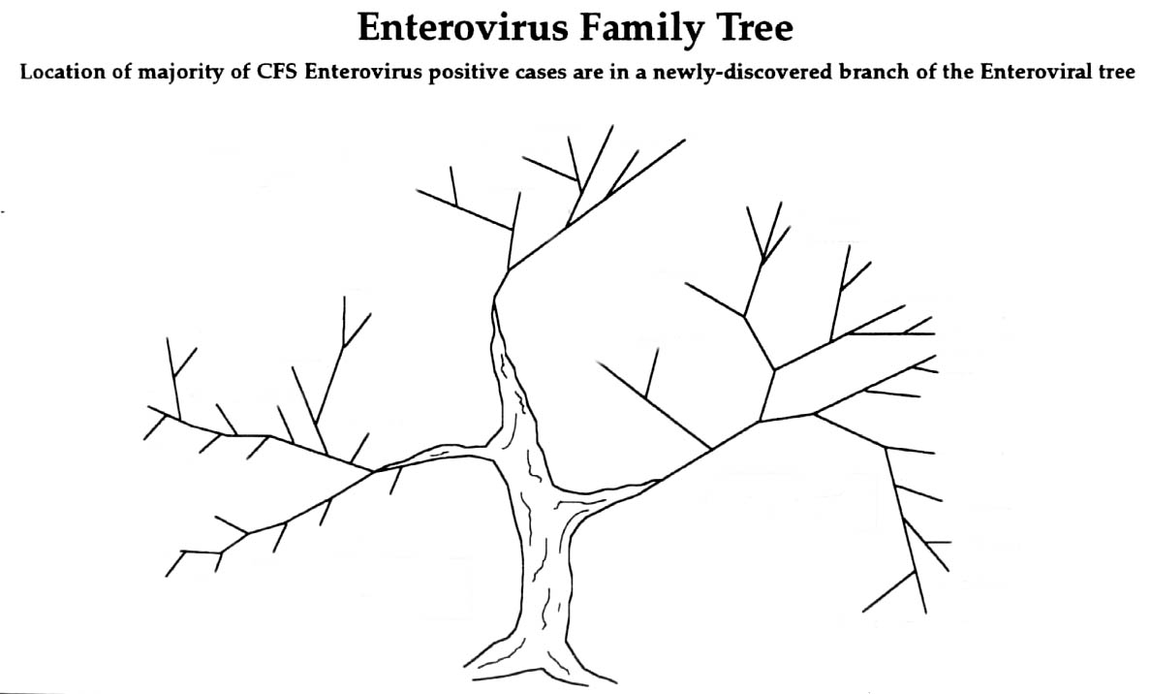
Coxsackie A34
Polio 1
Polio 2
Enterovirus 70
Polio 3
Polio 3a
CFS Patient 16
Primary Paralytic
Branch
Polio 2
Coxsackie A31
CFS Patient 15
CFS Patient 17
CFS Patient 14
CFS Patient 13
CFS Patient 18
CFS Patient 12
Non CFS 7
CFS Patient 11
Coxsackie B4A
CFS Patient 20
CFS Patient 19
CFS Patient 10
Echo 9
Non CFS 1
CFS Patient 9
Coxsackie B4
CFS Patient 8
Echo 7
Echo 11
Coxsackie B5
CFS Patient 7
Coxsackie A9
Non CFS 2
CFS Patient 6
Echo 20
Echo 3
Echo 4
CFS Patient 5
Coxsackie B1
Primary CFS
Branch
CFS Patient 4
Non CFS 3
Non CFS 6
Non CFS 5
Non CFS 6
CFS Patient 3
CFS Patient 1
CFS Patient 2
Coxsackie/ECHO
Branch

Slide 21
Secondary M.E. is Diffuse Brain Injury, 2e to…
Concussion Or Neck Injury: sports, MVA, occupational (hydraulic hammer),
Chemical: acute or chronic or additive as in toxic chemicals, pesticides, herbacides,
Post Immunization: particularly within 1-7 days of Hep B & Influenza + any neurotrophic or vascular trophic infection,
Or any combination of above with a positive SPECT

Slide 22
so… What is Chronic Fatigue Syndrome ?

Slide 23
The Official Interpretation of CFS
Lets be honest with ourselves according to:
(a) the NIH/CDC,
(b) the Insurance industry &
(c) 90% of the world’s Physicians
CFS is a Psychiatric manifestation.

Slide 24
CFS is based upon the 1988 & 1994 NIH/CDC Definitions, based on mistaken beliefs that:
CFS was due to EBV
This proved to be insupportable so CDC blamed the patients as having
An unimportant, uninsurable psychological illness

Slide 25
1988 CFS Definition
A definition of a psychological illness,
Is an illness with lots of complaints,
& No so significant physical findings.

Slide 26
1994 CFS Definition
Same as 1988 but to help prove CFS was a psychiatric disease they invited:
Toronto’s own Dr Susan Abby, the insurance darling
UK’s Dr Simon Wessely, another insurance darling

Slide 27
Most Physicians, Government Health bureaucracies and all insurance companies believe-
CFS patients are crazies who believe they have a physical illness when in reality they have an uninsurable psychological illness that in the UK may get them committed (sectioned) if they insist they are ill…

Slide 28
What Do Most Canadian GPs Believe?
CFS is a convenient garbage bag in which to place patients who are
to complicated,
they have no time for,
who think they know more than them,
CFS is a handy diagnosis since there is no clear diagnosis & no psychiatric treatment the patient will accept

Slide 29
Dr Beth Unger, CDC Atlanta
Dr Unger is the new Chief of Chronic Infectious Diseases at the CDC Atlanta headquarters.
She stated in the September CFS /M.E. Symposium in Ottawa that CFS was more than one disease.
Dr Unger is correct!

Slide 30
CFS Can Kill You
NIH researcher Dr David Poskanzer died of an Astrocytoma after investigating M.E. for 20-30 years,
NIH CFS Chief, Dr Stephen Straus died in 2007 of an Astrocytoma after investigating M.E. for 20 years.
At the CDC in February 1987 I diagnosed Dr Straus with a frontal lobe seizure. I suggested he have an MRI. He didn’t listen. He thought I was insulting him. Some 20 years later he died of a brain tumor.

Slide 31
What do I think CFS Represents?
90+% of physicians think CFS is a psychological illness or worse, a joke.
I know all gradual onset CFS patients have missed major pathologies.
Gradual onset CFS patients all have serious disease & usually multiple pathologies at the same time.

Slide 32
Missed Diagnoses: Lulu.com
If all CFS are various missed diagnoses & various significant diseases there can be, NO single viral or infectious cause, NO single test, & NO single treatment.
The single infectious agent, the single treatment or single test is a myth.
It is essential to investigate each organ & system of each patient thoroughly.

Slide 33
Missed Diagnosis
CNS Vascular d
Carotid/Vertebral d
Coronary & Heart d
Periph. vascular d
Autonomic diseases
POTS, Ehlers Danlos, Marfan
Clotting Factor d
Malignancies
MS
Diabetes
Renal & Hepatic d
Syphilis, Lyme, Brucellosis, TB
Von Economo
Metal & chemical & medication poisoning

Slide 34
Chronically Disabled Patients
Once in their lifetime, sooner better than later, all CFS and M.E. patients require a complete, systematic, scientific investigation of all of their organs and systems.
That doesn’t mean a few blood tests.

Slide 35
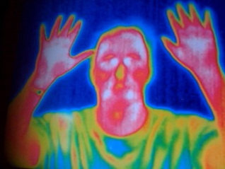
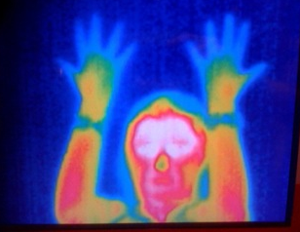
Thermogram
Healthy Father
Daughter with M.E. &
Severe Raynaud’s

Slide 36
What you and your doctor doesn’t know, about M.E. & CFS . . .
Notes:
Daughter Thermogram

Slide 37
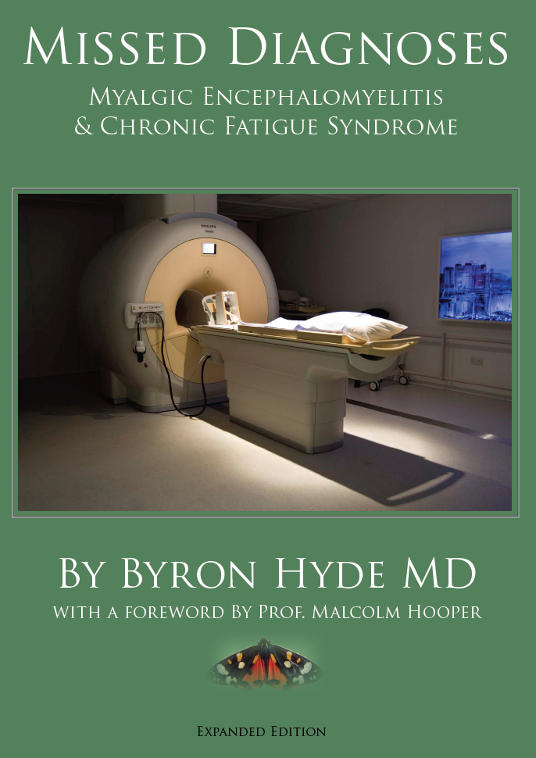
Missed Diagnoses
This inexpensive book can be purchased individually from www.Lulu.com
For approximately $20 Canadian, but if you purchase it through your organization, in more than 10 copies, it may be significantly less expensive.

Slide 38
Dr John Richardson at 80 years, stepping down from his Tiger Moth WWI fighter plane.
Dr Richardson, a country GP from Newcastle UK, was one of those responsible for kindling my interest in M.E.
Dr Richardson followed M.E. patients for up to 4 generations & demonstrated the genetic factors governing the illness of some M.E. patients.

Slide 39
Fibromyalgia, The Cause
Like CFS there are many causes giving rise to Fibromyalgia.
The best way to cause Fibromyalgia is to expand the vascular system, like drinking a few beers and potato chips.
An even better way is a Persantine Stress test which instantly expands the blood vessels. Great way to experience pain.

Slide 40
The Cause of Fibromyalgia

Slide 41
3 Simultaneous August 1984 epidemics
1: Lake Tahoe, School Epidemic
2: S. Carolina, Symphony, Epidemic
3: Ontario/ Quebec Pan-epidemic clusters,

Slide 42
August 1984 Cohorts

Slide 43
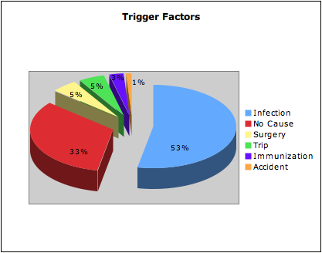
Trigger factors M.E./CFS, 1200 patients 1984-1990

Slide 45
Trigger factors in 53
Consecutive M.E. & CFS patients
Notes:
Whereas in the 1984-1990 viral epidemic period 53 % of our cases followed what appeared to be a viral or infectious injury, in our 2008 study where there was no apparent infectious epidemic we continued to see a much lesser number of M.E. patients but now the post infectious group had fallen from 53% to 9% of our total. Curiously what made up the difference appeared to be 42% fell chronically ill following one of two immunizations, Recombinant Hepatitis B immunization and influenza immunization. Whereas in the 1984-1990 study 33% were gradual onset, in the 2008 study 23% were post major trauma, MVA, sports or locomotive CNS injuries.

Slide 46
CFS Illness Immediately Following RHb Immunization
65 Cases reported to Health Canada,
Health Canada published research in Canadian Medical Journal, investigation reveals no illness,
No investigation ever done on the 65 patients
Following year, Freedom of Information, Health Canada stated Research destroyed due to lack of space.
Two of reported patients died shortly after.

